Slide 1
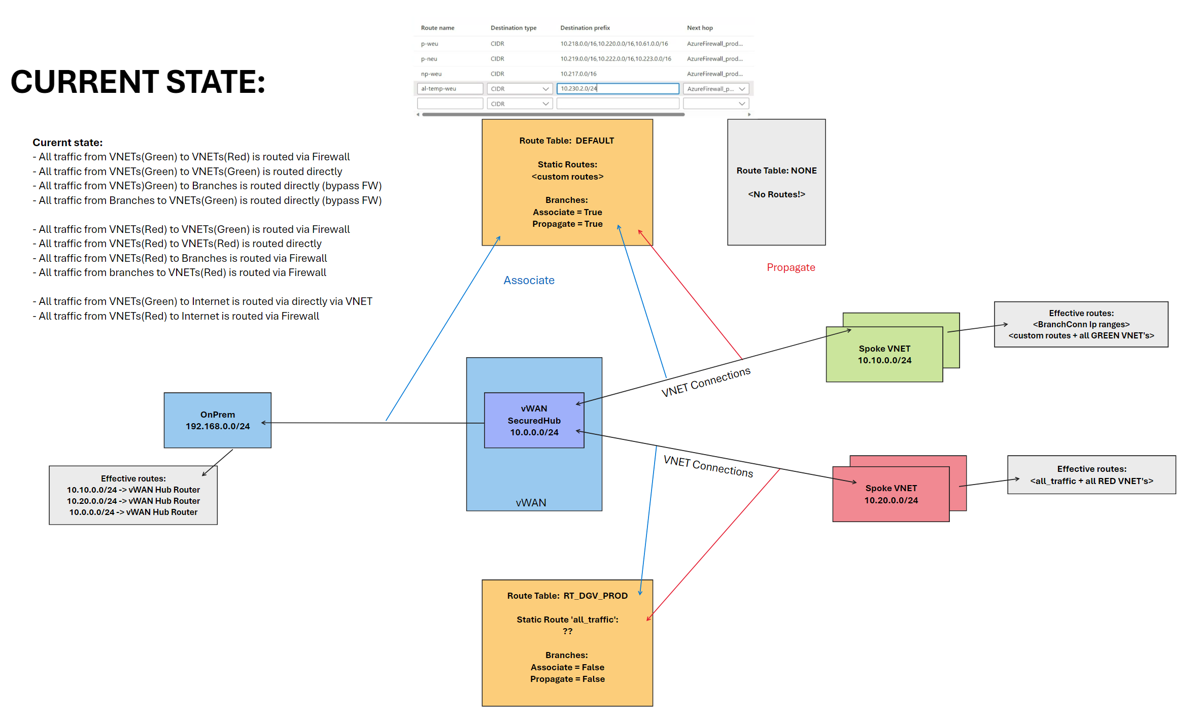

Slide 2
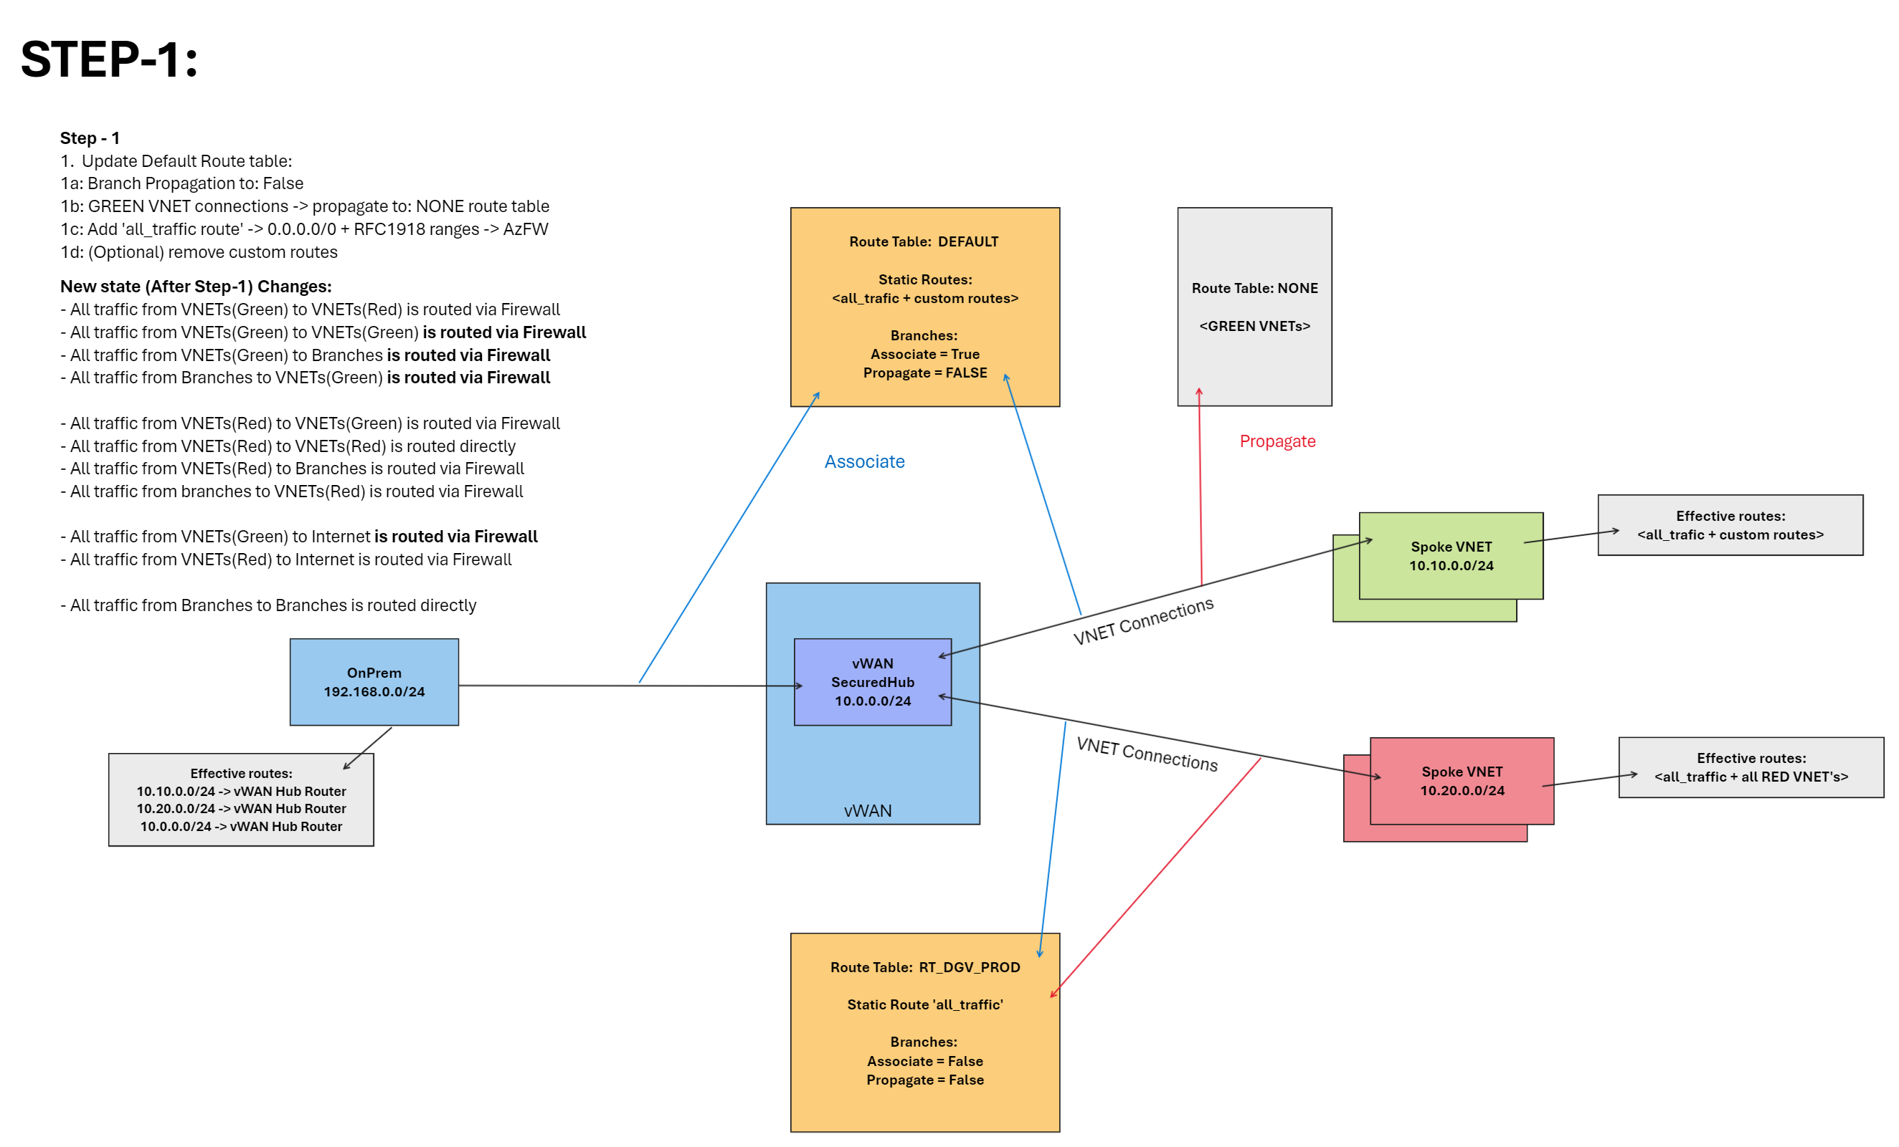

Slide 3
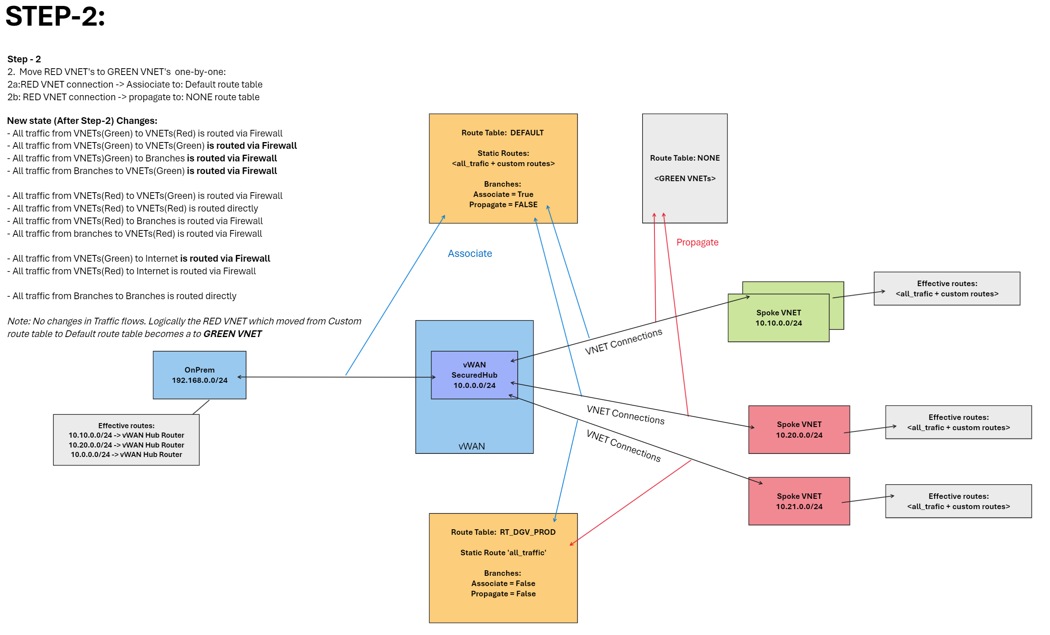

Slide 4
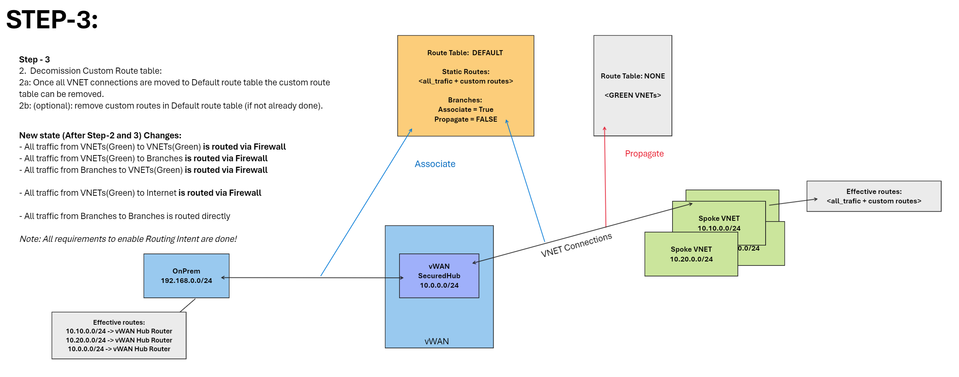

Slide 5
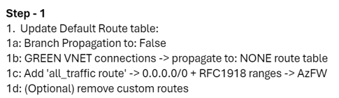
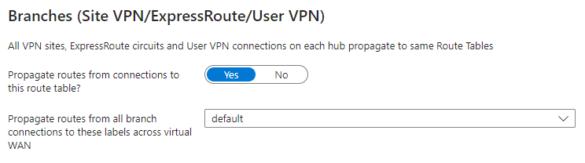
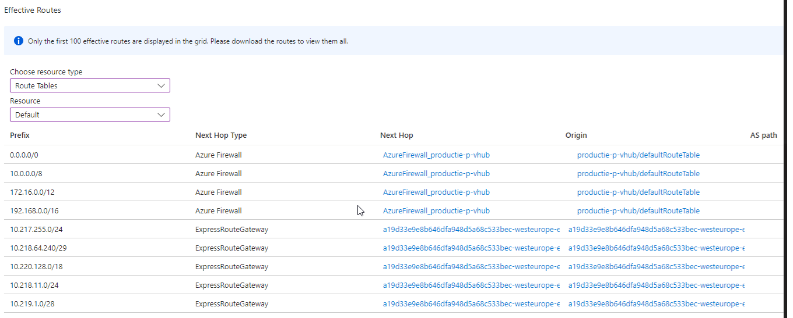
Network
10.0.0.0/8
139.156.151.74/32
139.156.151.76/32
172.16.0.0/12
192.168.0.0/16
Last Wednesday we had the change for making the adjustments to the default Route Table as discussed.
Step One was planned and didn’t bring the desired state we were hoping for.
Let’s begin from the start:
We changed the Branch propagation to No (Screenshot just for explanation purposes)
And the changed the propagation of the connected vnets (green) to the None Route Table
And last we replaced the current entries for the all traffic.
The result was that we again lost connectivity to the Leidsche (LVP) network.
So we still have asynchronized traffic. In VWAN all traffic goes to the Azure Firewall. But from a host perspective a direct route is still known.
The strange part is that we saw somethings we can’t explain.
When we disabled the propagation of the branches and the vnets the number of routes stays the same. So no drop in Connections and certainly not the desired state.
I expected to see only the top 4 entries in the Default.
When we propagate the lvp-vnet to the None Route Table we saw that this route automatically was added to the next hob ExpressRoute.
Below some of the entries in the Route Table
When LVP vnet propagated to None Route Table
When LVP vnet propagated to Default Route Table
Questions:
How long does it take in the Route Table (effective) for disabeling the Propagation set to No for the branches?
How long does it take in the Route Table (effective) for disabeling the Propagation set to None Route Table of vnet connections?
How much time do we need to take into consideration before applying a different setting of branches of vnet connections?
We tried several different settings but saw no improvement of change in the effective routes.
Could it be that the Routes KPN advertises over the ExpressRoute is causing the issue?
Now KPN Advetises these Routes
10.61.160.32/27 | Virtual Network Connection | /subscriptions/f49c3596-4254-4249-b2f9-8f32d6ac2abf/resourceGroups/network-p-rg/providers/Microsoft.Network/virtualHubs/productie-p-vhub/hubVirtualNetworkConnections/peer-to-lvp-vnet
10.61.160.128/25 | Virtual Network Connection | /subscriptions/f49c3596-4254-4249-b2f9-8f32d6ac2abf/resourceGroups/network-p-rg/providers/Microsoft.Network/virtualHubs/productie-p-vhub/hubVirtualNetworkConnections/peer-to-lvp-vnet
10.61.160.32/27 | ExpressRouteGateway | /subscriptions/f49c3596-4254-4249-b2f9-8f32d6ac2abf/resourceGroups/network-p-rg/providers/Microsoft.Network/expressRouteGateways/a19d33e9e8b646dfa948d5a68c533bec-westeurope-er-gw
10.61.160.128/25 | ExpressRouteGateway | /subscriptions/f49c3596-4254-4249-b2f9-8f32d6ac2abf/resourceGroups/network-p-rg/providers/Microsoft.Network/expressRouteGateways/a19d33e9e8b646dfa948d5a68c533bec-westeurope-er-gw

